Slide 1


DEPARTMENT OF COMPUTER SCIENCE & ENGINEERING
SCHOOL OF COMPUTING
10214CS601 MINOR PROJECT -2
SUMMER SEMESTER(2023-2024)
REVIEW-I
“GARBAGE CLASSIFICATION USING CNN”
SUPERVISED BY
PRESENTED BY
Dr.Vinoth kumar S, ME,Associate Professor
1.G.MEGHANA (VTU20133)(21UECS0198)
2.S.VARUN KUMAR (VTU20180)(21UECS0717)
3.M.SAI GOWTHAM (VTU20213)(21UECM0164)

Slide 2
OVERVIEW
ABSTRACT
OBJECTIVE
INTRODUCTION
LITERATURE REVIEW (SOFT COPY OF PAPERS TO BE LINKED AS HYPERLINK)
DESIGN AND METHODOLOGIES
IMPLEMENTATION
TESTING
INPUT AND OUTPUT
INCLUDE DEMO VIDEO-1 (Till REVEW-1)
INCLUDE DEMO VIDEO-2(Complete Implementation of Project)
CONCLUSION
WEB REFERENCES LINK (TILL REVIEW DATE ALL LINKS TO BE INCLUDED DAY WISE)
PLAGIARISM REPORT OF PPT
REFERENCES

Slide 3
ABSTRACT
In today's rapidly advancing technological landscape, managing waste has become a critical challenge. Garbage classification is a pivotal step towards efficient waste management, promoting recycling, and reducing environmental impact.
The aim to create a robust model capable of accurately identifying and classifying diverse types of waste items, laying the foundation for automated waste sorting systems to conserve environment by properly disposing them
The methodology involves pre-training the VGG16 convolutional neural network (CNN) on a large and diverse dataset, such as ImageNet, to leverage generalized feature learning, followed by fine-tuning the model on a specific garbage dataset for ensuring adaptation to the nuances of garbage classification in real-world scenarios.
The results demonstrate the effectiveness of the proposed approach in achieving high accuracy in garbage classification. The model's performance is evaluated through metrics such as precision, recall, and F1 score, showcasing its ability to differentiate between different waste categories.
The integration of VGG16 enhances garbage classification, yielding promising results that endorse the viability of automated waste sorting systems and contribute to the advancement of sustainable waste management practices through cutting-edge technology.

Slide 4
OBJECTIVES
1.Aim of the Project : The aim is to leverage the VGG16 convolutional neural network (CNN) architecture for improved garbage classification accuracy. Specifically, the focus is on contributing to the feasibility of automated waste sorting systems, with the ultimate goal of advancing sustainable waste management practices through cutting-edge technology.
2.Scope of the project:
Automation of Waste Sorting:
Contribution to the development of automated waste sorting systems for increased efficiency.
Global Application:
Consideration of the adaptability of the model for global implementation, addressing diverse waste management practices and regulations.
Interdisciplinary Collaboration:
Opportunities for collaboration with environmental scientists, policymakers, and technology developers to create an interdisciplinary approach to waste management.
Environmental Impact Assessment:
Future evaluations on the environmental impact of automated waste sorting systems and adjustments to minimize ecological footprints.

Slide 5
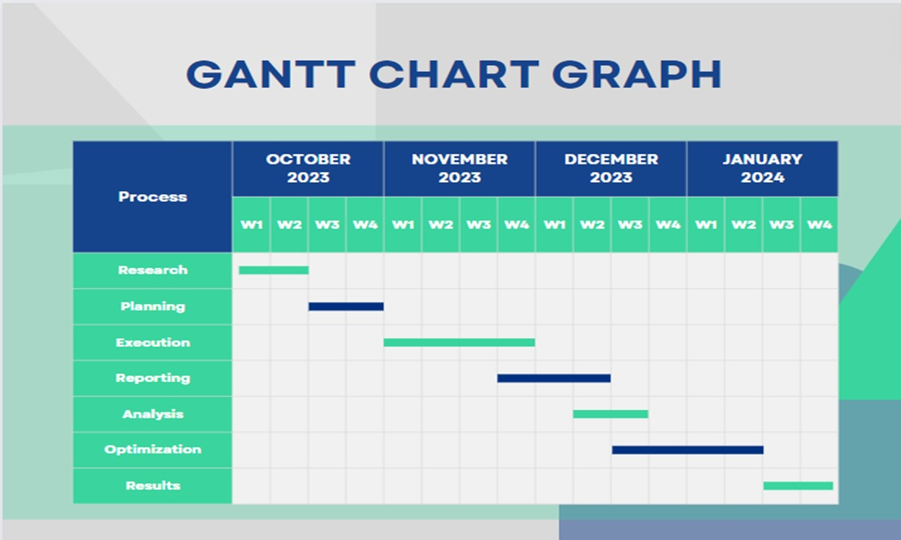
TIMELINE OF THE PROJECT

Slide 6
INTRODUCTION
In the face of a growing waste crisis, can innovative technology redefine how we approach and handle garbage, paving way for a sustainable future?
As waste accumulates at an unprecedented rate, this project aims to unveil a transformative solution at the intersection of technology and environmental stewardship.
At the heart of this initiative is the utilization of the VGG16 convolutional neural network (CNN), a sophisticated tool that goes beyond algorithms to reshape how we classify garbage.
The impact of this project extends beyond the digital realm – envision automated waste sorting systems seamlessly integrated into our daily lives, offering cleaner surroundings and a more sustainable future.
This isn't just about lines of code; it's about transforming communities, fostering environmental responsibility, and paving the way for a future where the management of waste is synonymous with efficiency, cleanliness, and a healthier planet.
Beyond the technicalities, understand how this intelligent system has the potential to revolutionize waste classification, paving the way for automated sorting systems that directly impact public spaces, creating cleaner, more sustainable communities.

Slide 7
LITERATURE REVIEW
S.No | Author’s Name | Paper name and publication details | Year of publication | Main content of the paper
1 | ZHUANG KANG, JIE YANG, GUILAN LI , AND ZEYI ZHANG | “An Automatic Garbage Classification System Based on Deep Learning”, Jiangxi University of Science and Technology | 2020 | The paper presents an enhanced garbage classification algorithm based on ResNet-34 with three modifications: multi-feature fusion, feature reuse of residual units, and activation function optimization
2 | Wei-Ta Chu , Shanshan Meng | A study of Garbage classification with convolution neural networks | 2020 | Various approaches, including SVM with HOG features and CNN with and without residual blocks, are studied and comprehensively evaluated

Slide 8
S.No | Author’s Name | Paper name and publication details | Year of publication | Main content of the paper
3 | Smith, J. | "A Deep Learning Approach for Garbage Classification" | 2022 | Investigates the effectiveness of CNN models in classifying different types of garbage for waste management.
4 | Johnson, A. | "Enhancing Waste Sorting with Convolutional Neural Networks" | 2021 | Explores the use of CNNs to improve the accuracy and efficiency of garbage sorting processes.
5 | Miller, R. | "Machine Learning Techniques for Waste Classification" | 2020 | Compares different machine learning algorithms for waste classification and proposes a novel approach.

Slide 9
S.No | Author’s Name | Paper name and publication details | Year of publication | Main content of the paper
6 | Williams, L. | "Automated Garbage Sorting Using Machine Learning" | 2023 | Proposes an automated system for garbage sorting using machine learning techniques.
7 | Brown, M. | "Deep Reinforcement Learning for Waste Management" | 2022 | Investigates the use of deep reinforcement learning algorithms for waste management and recycling.
8 | Wilson, S. | "Smart Garbage Classification System for Sustainable Waste Management" | 2021 | Presents a smart garbage classification system that utilizes IoT and machine learning technologies for sustainable waste management.

Slide 10
S.No | Author’s Name | Paper name and publication details | Year of publication | Main content of the paper
9 | Umut Özkaya ,Levent Seyfi | Fine-Tuning Models Comparisons on Garbage Classification for Recyclability | 2019 | Transfer learning, employing fine-tuned models such as Alexnet, VGG16, Googlenet, and Resnet, was implemented for efficient training and higher accuracy
10 | Jian-ye Yuan,1 Xin-yuan Nan , 1 Cheng-rong Li,2 and Le-le Sun | Research on Real-Time Multiple Single Garbage Classification Based on Convolutional Neural Network | 2020 | 23-layer convolutional neural network (CNN) model is designed in this paper, with the emphasis on the real-time garbage classification, to solve the low accuracy of garbage classification and recycling and difficulty in manual recycling.

Slide 11
DESIGN AND METHODOLOGIES
MODULE 1: Data acquisition and Data preprocessing
MODULE 2: Description about Convolution Neural Network(CNN)
MODULE 3: Model Implementation
MODULE 4: Output
Training and Evaluation of CNN Models
Data Collection and Preparation
Collection and preprocessing of image datasets is critical for the accurate training of CNN models for trash classification.
Model Training and Optimization
CNN models are trained using backpropagation and optimization techniques such as stochastic gradient descent to improve their accuracy and performance.
Model Evaluation and Accuracy Analysis
CNN models are evaluated using metrics such as accuracy, precision, and recall to measure their reliability and performance in trash classification.

Slide 12
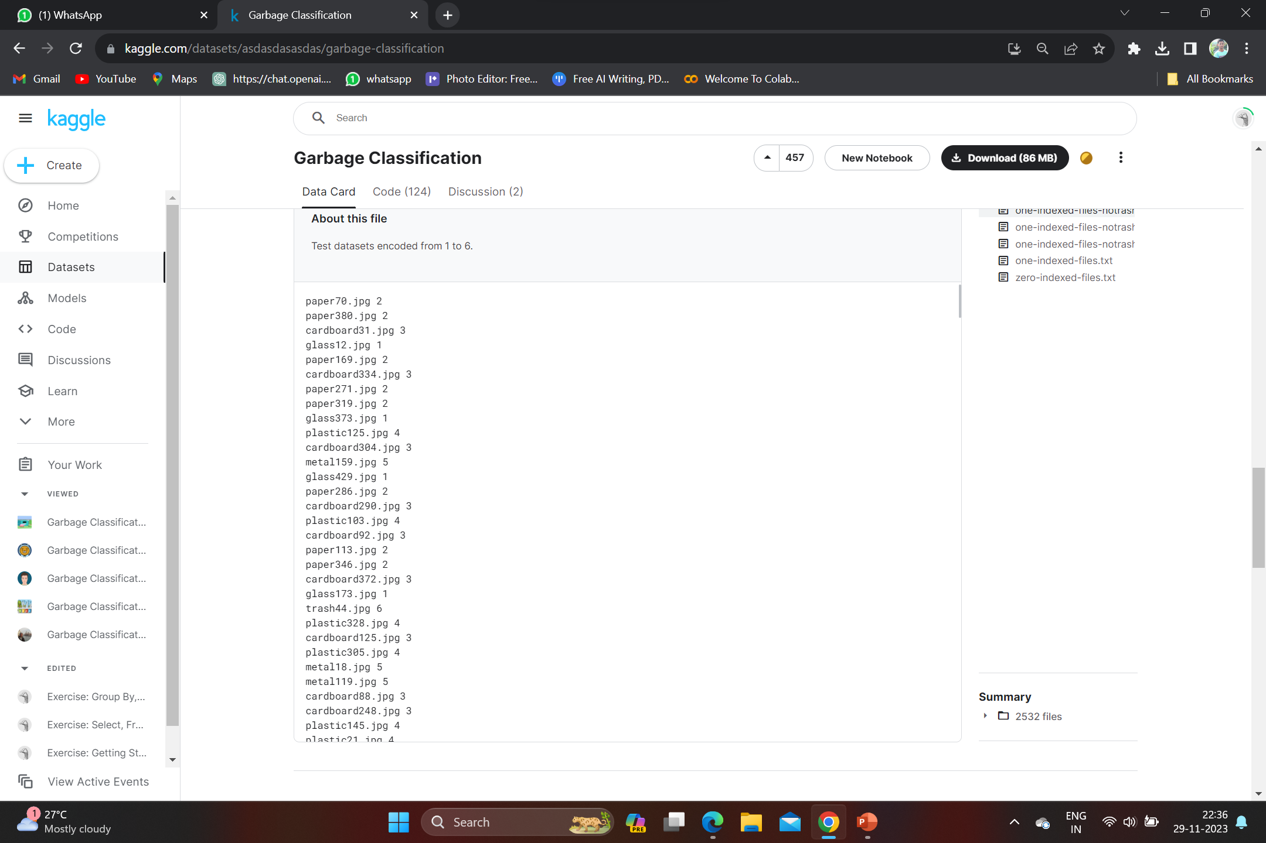
MODULE 1
Step:1 Data Acquisition
For garbage classification, we utilize the images of the dataset dedicated to the garbage classification task on Kaggle1 .This dataset includes totally 2527 images in which a single object of garbage is present on a clean background. Lighting and pose configurations for objects in different images is different. All these images have the size of 384 × 512 pixels and belong to one of the six recycling categories: cardboard, glass, metal, paper, plastic, and trash. To train deep neural networks, we need a large amount of training images. With flipping and rotation, we augment the dataset to 10108 images, which was randomly split into train sets of 9,095 images and test sets of 1,013 images.

Slide 13
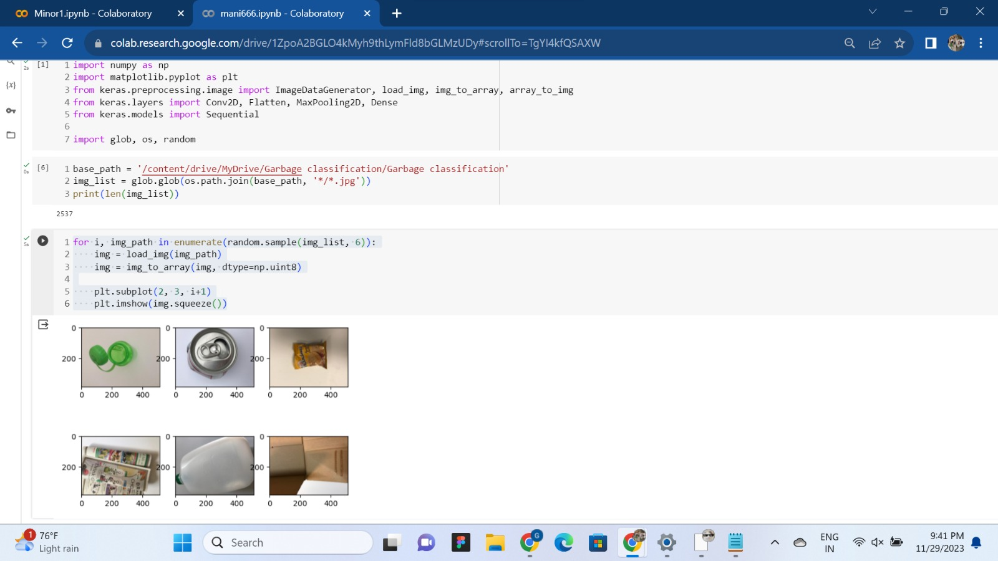
Step 2: Preprocessing the data
The first step focuses on image loading, array conversion, and visualization. It randomly selects 6 images from a given list, loads and converts them into NumPy arrays, and then displays them in a 2x3 grid of subplots using Matplotlib. While this code snippet does involve some basic data preprocessing, its primary purpose is visualizing images rather than preparing data for training a machine learning model.

Slide 14
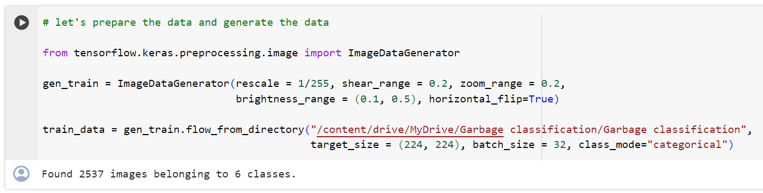
Step 2: Preprocessing the data
The second code snippet is more centered on data preprocessing for training a neural network. It employs Keras' ImageDataGenerator to perform data augmentation on images, including rescaling, shearing, zooming, shifting, and flipping. The data generators are configured for training and testing, creating batches of augmented images from specified directories. Additionally, the code establishes a mapping of class indices to labels for reference during training.

Slide 15
MODULE 2
Convolutional neural networks
Convolutional neural networks (CNNs) are a type of deep learning algorithm that are well-suited for image classification tasks. CNNs are able to extract features from images and learn to identify patterns, which makes them ideal for garbage classification. The VGG16 architecture is a CNN architecture that was developed by the Oxford Visual Geometry Group. VGG16 is a deep architecture, which means that it has a large number of layers. This allows VGG16 to learn complex patterns from images.
WORKING:
The image is passed through the convolutional layers of the VGG16 architecture.
These layers extract features from the image, such as edges and shapes.
The features are passed through the pooling layers, which downsample the image by taking the maximum or average value of each subregion.
This reduces the computational cost of the network and helps to prevent overfitting.
The features are passed through the fully connected layers, which combine the features into a single representation of the image.
The final layer of the network is a SoftMax layer, which assigns probabilities to each of the garbage classes.
The garbage type with the highest probability is the predicted class.

Slide 16
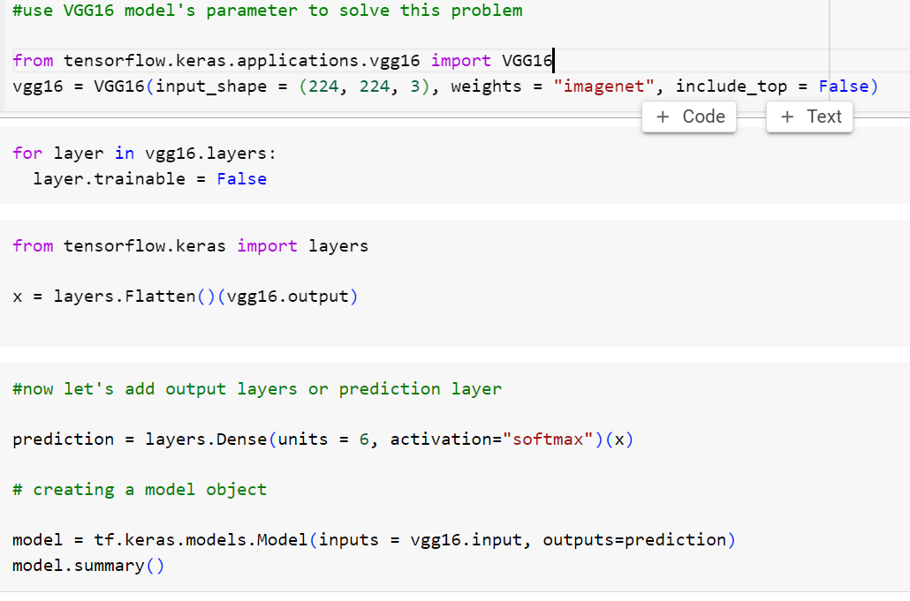
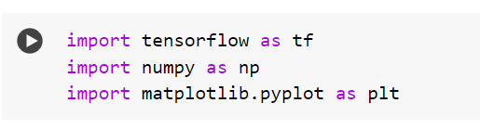
MODULE 3: CNN IMPLEMENTATION
Importing Libraries and Preprocessing

Slide 17
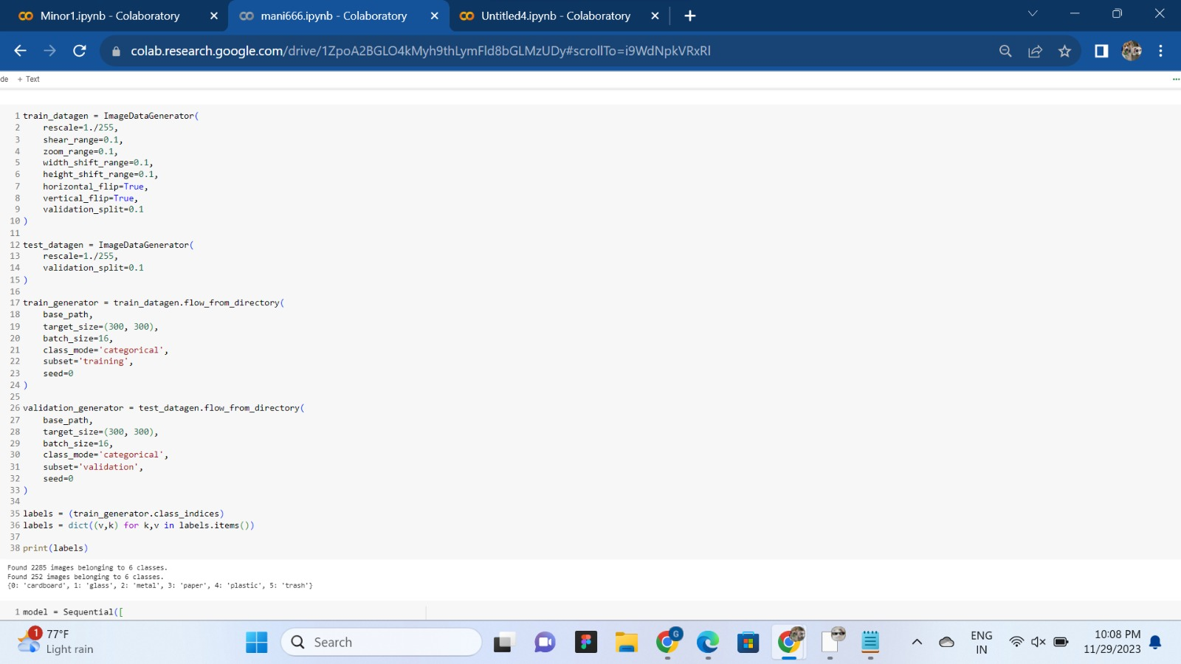
SPLIT THE DATASET INTO TRAIN AND TEST SET

Slide 18
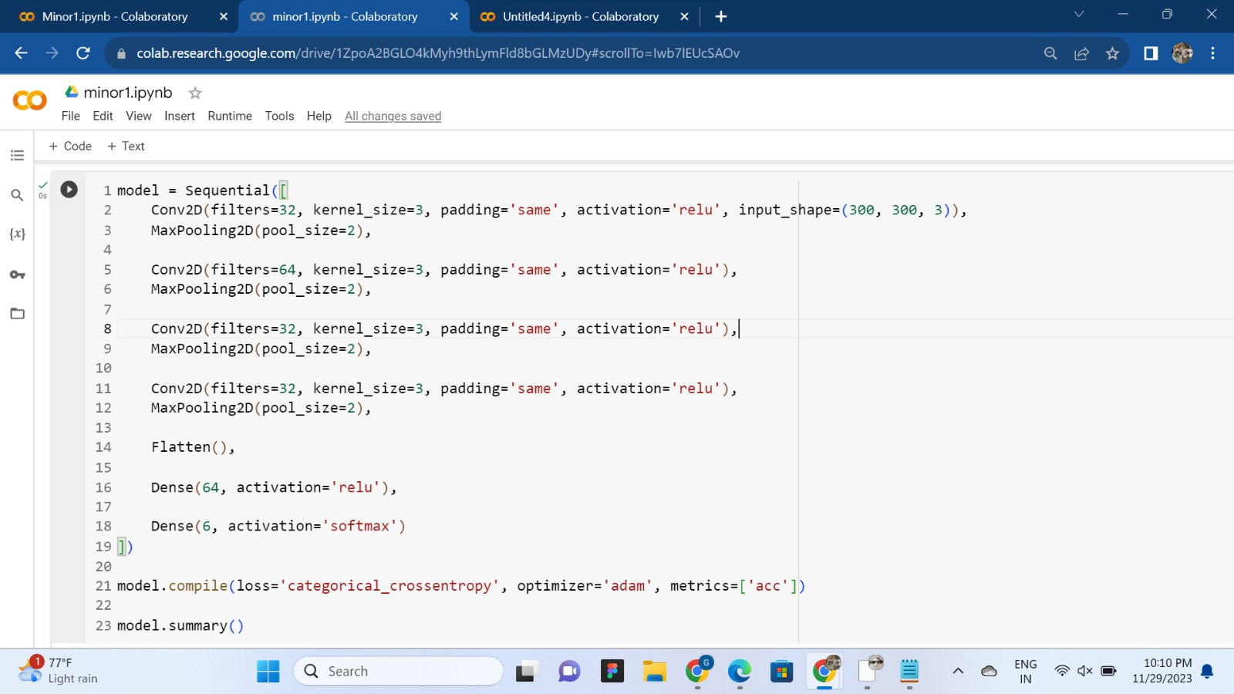
MAX POOLING FOR REDUCING THE SIZE

Slide 19
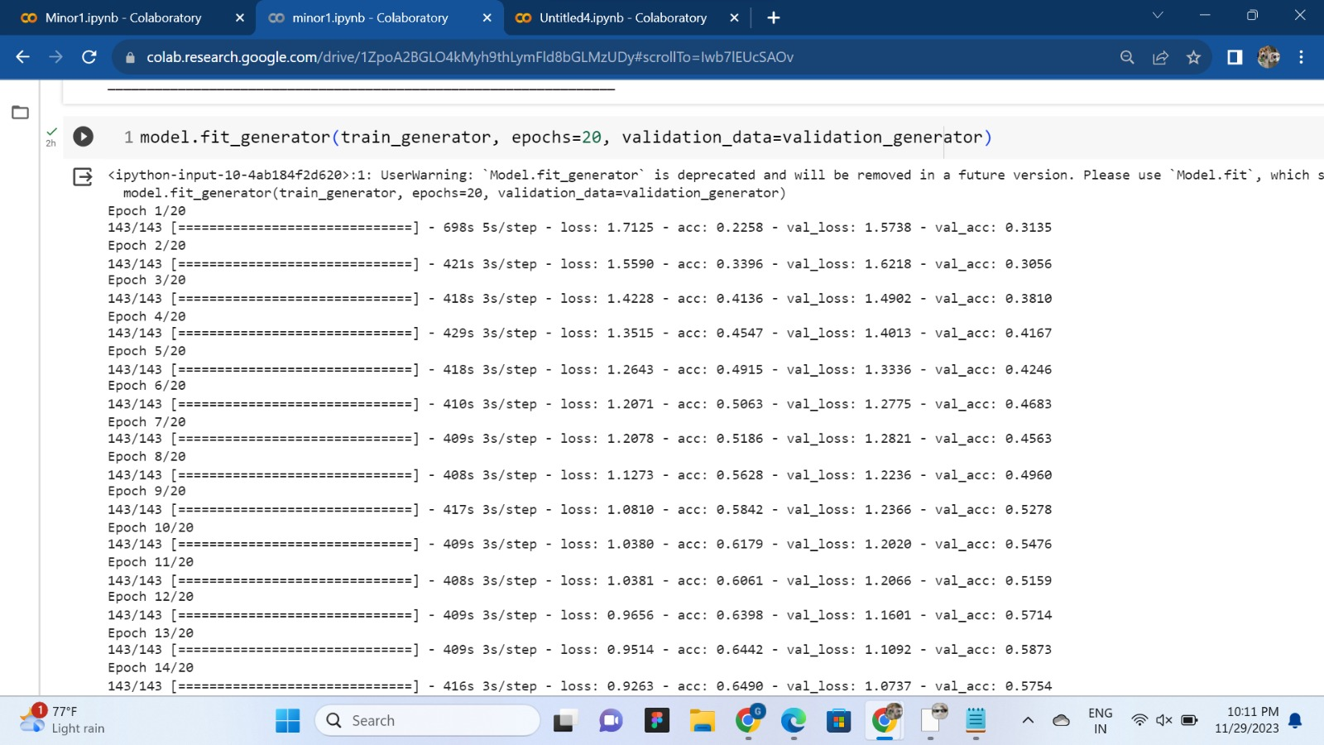
TRAINING THE MODEL BY 20 EPOCHS INITIALLY TO IMPROVE ACCURACY IN EVERY ITERATION

Slide 20
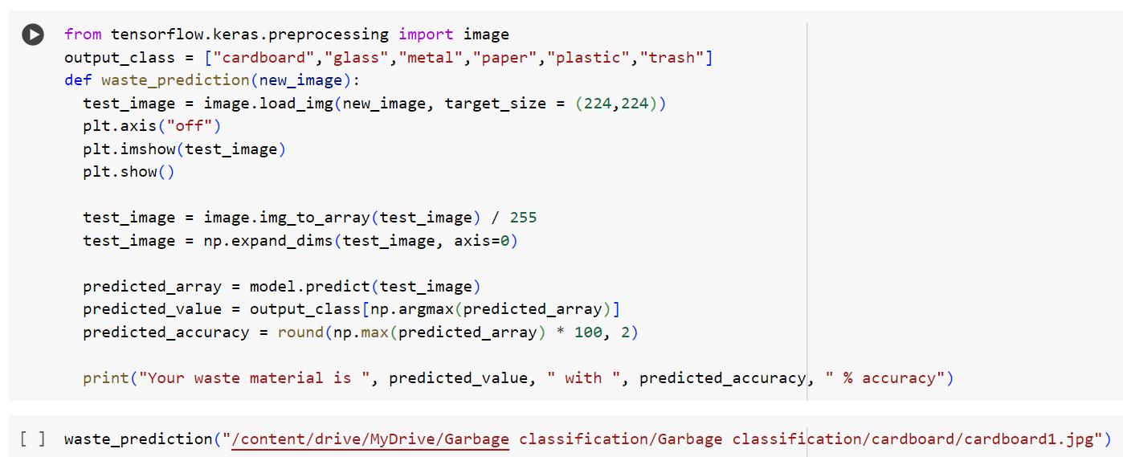
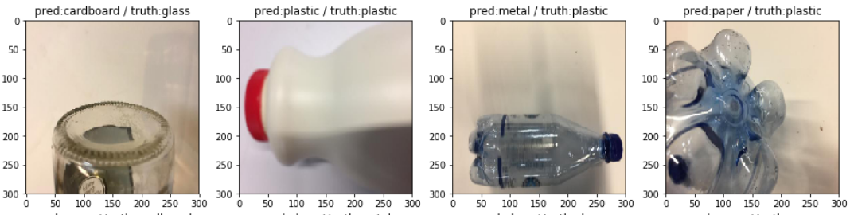
MODULE 4
OUTPUT: Prediction by model vs Actual Image

Slide 21
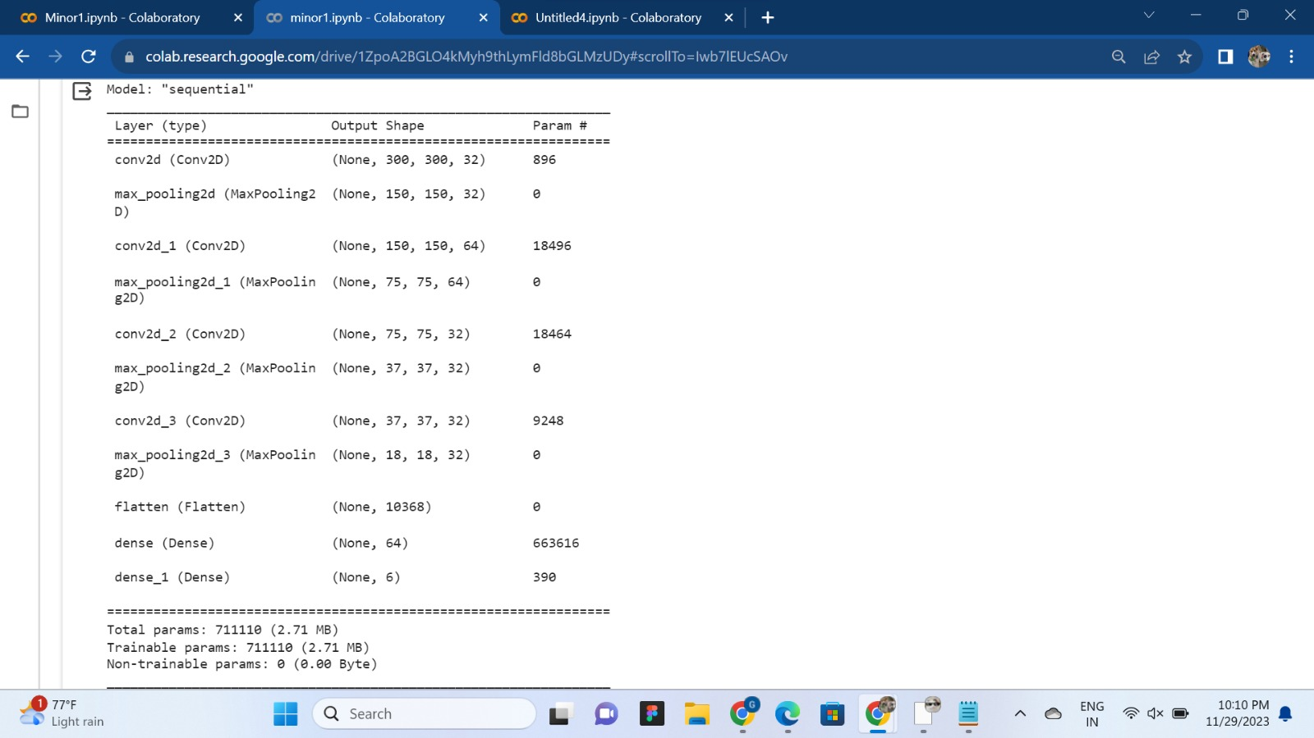
MAX POOLING OUTPUT

Slide 22
IMPLEMENTATION
Architecture Diagram
Data –Flow Diagram
Use Case Diagram
Class Diagram
Activity Diagram
Sequence Diagram
Collaboration Diagram(If applicable)
E-R Diagram

Slide 23
Architecture Diagram
Output layer
Input layer
Hidden
layer
Dropout layer
Convolution+Relu
Pooling
Convolution+Relu
Pooling
The Convolutional Neural Network (CNN) architecture consists of several key layers. Beginning with the input layer, where raw pixel values of an image are fed into the network, the data flows through convolutional layers, each labeled uniquely, employing grids to represent convolutional filters. Rectangles labeled "ReLU" follow these convolutional layers, denoting the application of the ReLU activation function. Subsequent pooling layers, named "Max Pooling" or "Average Pooling," work to reduce spatial dimensions. The flattened layer condenses the data into a one-dimensional vector, leading to fully connected layers labeled "Dense." The output layer, marked as "Output," produces raw scores, with a "Softmax" step connecting to indicate the application of the softmax activation function for classification tasks. Connecting arrows illustrate the flow of information through the network. The actual structure may vary based on specific CNN models and tasks

Slide 24
Data –Flow Diagram
Data collection
The data flow in the garbage classification project begins with the collection of original garbage images from diverse sources, denoted as "Data Sources.“
These images undergo a systematic organization process labeled as "Data Collection." Subsequently, the data is augmented for training purposes through the "Data Augmentation" process. The augmented dataset, known as "Training Data," serves as the input for the Convolutional Neural Network (CNN) architecture designed for garbage classification, represented as "CNN.“
The model undergoes training through the "Training Process," resulting in a "Trained Model." The model's performance is evaluated using a separate set of data termed "Testing Data." The "Inference Process" utilizes the trained model to make predictions, and the output, representing the predicted classes, is stored in the final data store labeled "Predictions." This comprehensive flow encapsulates the journey from data collection to model training and ultimately the generation of predictions.
Data preprocessing
Data Augmentation
Training Data
CNN
Training Process
Trained model
Inference Process
Testing Data
Testing Data
Predictions

Slide 25
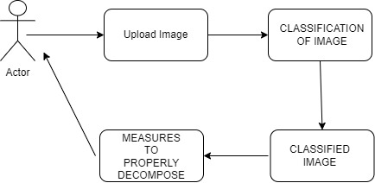
Use Case Diagram
This use case diagram outlines the interactions between actors and the system, depicting the main functionalities and relationships in the garbage classification process. The relationships between use cases help to understand the flow and dependencies in the system
Upload Image -> Classify Garbage:
Indicates that uploading images is a prerequisite for the garbage classification process.
Classify Garbage -> Measures:
Indicates that displaying the classification results is a subsequent step after garbage classification. These were the measures to decompose

Slide 26
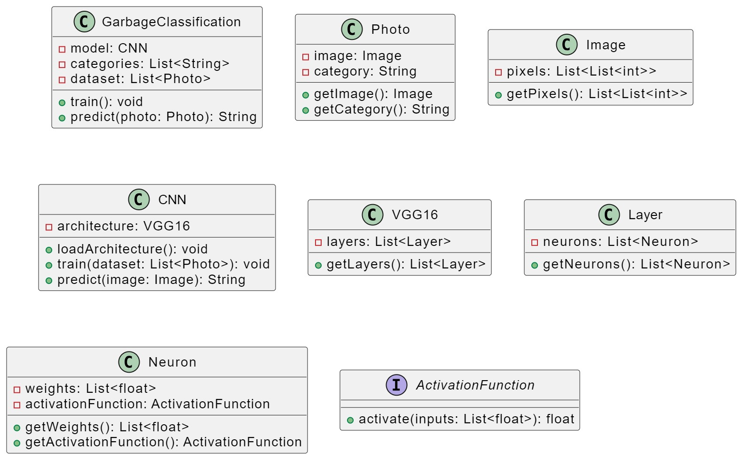
Class Diagram
Attributes and methods associated with class depend on the specific functionalities it provides, such as handling user input, managing image uploads, and coordinating the classification process.
The GarbageClassifier class is crucial for the machine learning aspect of the system. It encapsulates the trained model, which is the result of the machine learning process using a dataset of garbage images. This class typically has a method, classify(image), that takes an input image and applies the pre-trained model to determine the classification.

Slide 27
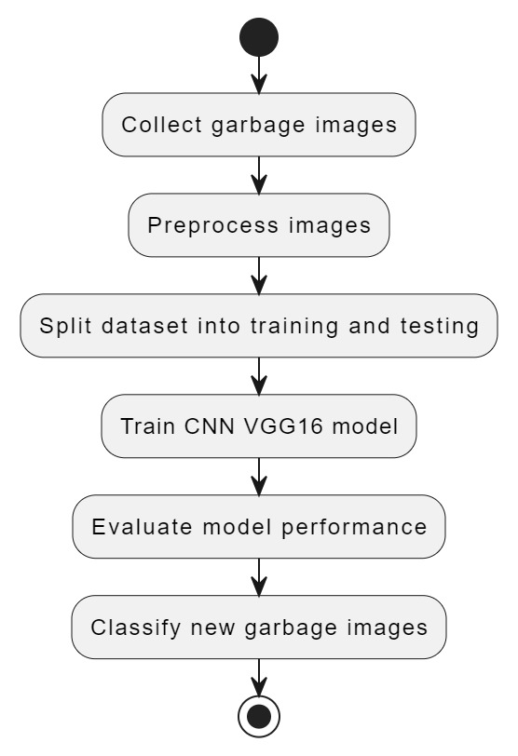
Activity Diagram
This diagram depicts the high-level activities involved in the process, including uploading an image, classifying garbage, displaying the classification, and system maintenance.
Arrows indicate the flow of control between activities, showing the sequence in which they occur.
This textual representation provides a high-level overview of the activities and their interactions in the garbage classification system.

Slide 28
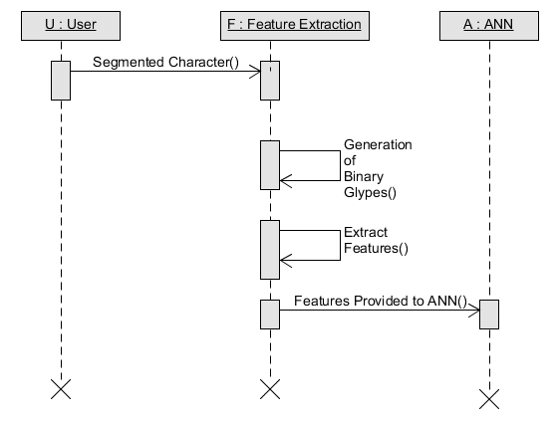
Sequence Diagram
User: Uploads Image :Sends the image to the AutomatedSystem.
Feature extractor- Invokes the GarbageClassifier to classify the uploaded image.
Which loads the pre-trained model for classification.
After passing the image through Relu+Pooling multiple times image reduced and sent to the ANN.
Final step is to display the classification result to the user

Slide 29
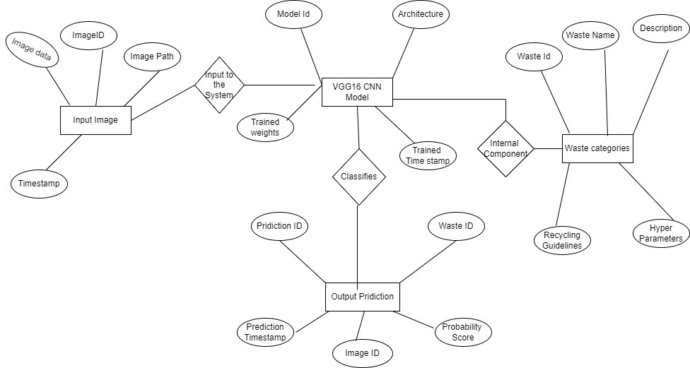
E-R Diagram
The ER Diagram workflow starts with processing "Input Image" through the "VGG16 CNN Model," resulting in "Output Predictions" that link back to the original image and the predicted waste category in "Waste Categories." The structured relationships between these entities form a cohesive system for image prediction and waste categorization.
With these detailed attributes and relationships, not only predicts waste categories but also offers valuable information about the images, model architecture, and waste categories themselves, creating a comprehensive framework for image-based waste categorization.

Slide 30
REFERENCES
Shanshan Meng; Wei-Ta Chu,A Study of Garbage Classification with Convolutional Neural Networks. (2020, February 1). IEEE Conference Publication, IEEE Xplore. https://ieeexplore.ieee.org/abstract/document/9181311
An automatic garbage classification system based on deep learning. (2020). IEEE Journals & Magazine | IEEE Xplore. https://ieeexplore.ieee.org/abstract/document/9144549/
Common garbage classification using MobileNet. (2018, November 1). IEEE Conference Publication | IEEE Xplore. https://ieeexplore.ieee.org/abstract/document/8666300
Tong, Y., Liu, J., & Liu, S. (2020). China is implementing “Garbage Classification” action. Environmental Pollution, 259, 113707. https://doi.org/10.1016/j.envpol.2019.113707
K. He, X. Zhang, S. Ren and J. Sun, "Deep Residual Learning for Image Recognition", 2016 IEEE
Conference on Computer Vision and Pattern Recognition (CVPR), pp. 770-778, Jun. 2016. M. Yang and G. Thung, "Classification of Trash for Recyclability Status", Stanford University CS229, [online] Available: http://cs229.stanford.edu/proj2016/report/ThungYang-ClassificationOfTrashForRecyclabilityStatus-report.pdf.
H. Khan, Transfer learning using mobilenet, [online] Available: https://www.kaggle.com/hamzakhanltransfer-Iearning-using-mobilenet.
P. Gupta, Using CNN [Test Accuracy- 84%], [online] Available: https://kaggle.com/pranavmicr07/using-CNN-test-accuracy-84.

Slide 31
THANK YOU

